Slide 1
Building Android apps – Week 2
2843-201710_MCS4993_M:Topics in MA/CS
2843-201710_MCS5993_M:Topics in Computer Science

Slide 2
Agenda
Hello World assignment
Java test
Github
Chapter 2 HFAD – Building Interactive apps

Slide 3
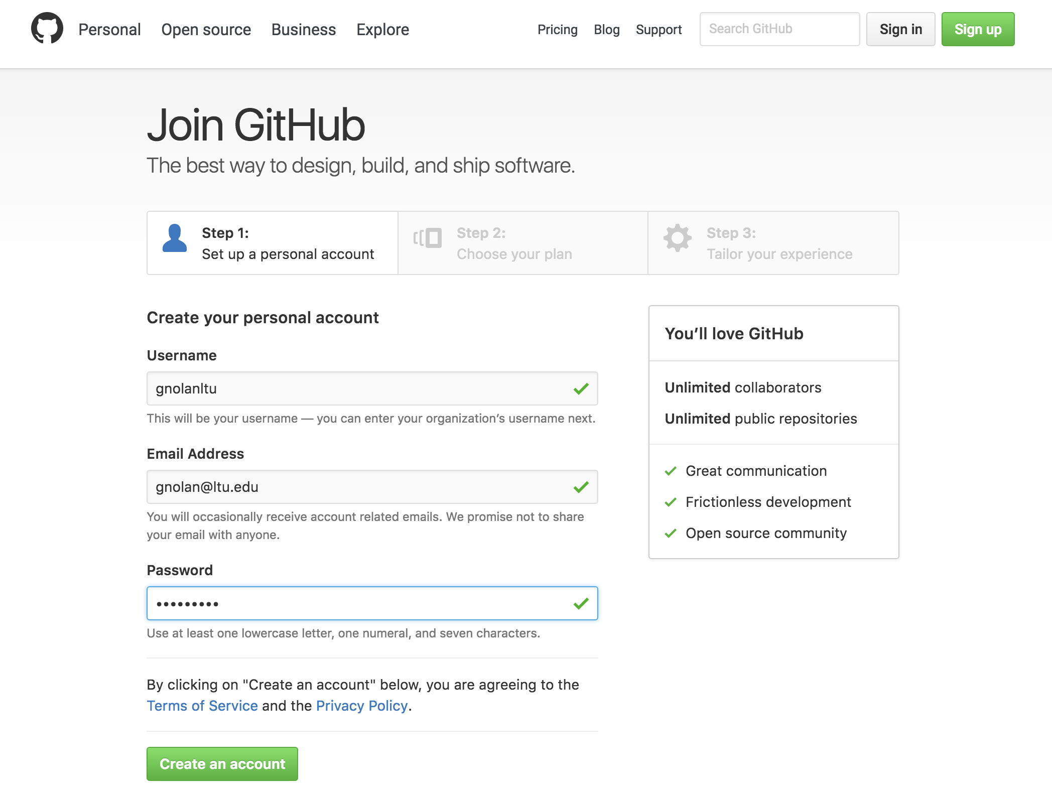
Github
Notes:
Enter information as shown
Next Page -> choose free plan
Next Page -> skip this step
Next click start a project – it’ll ask you to verify your email address

Slide 4
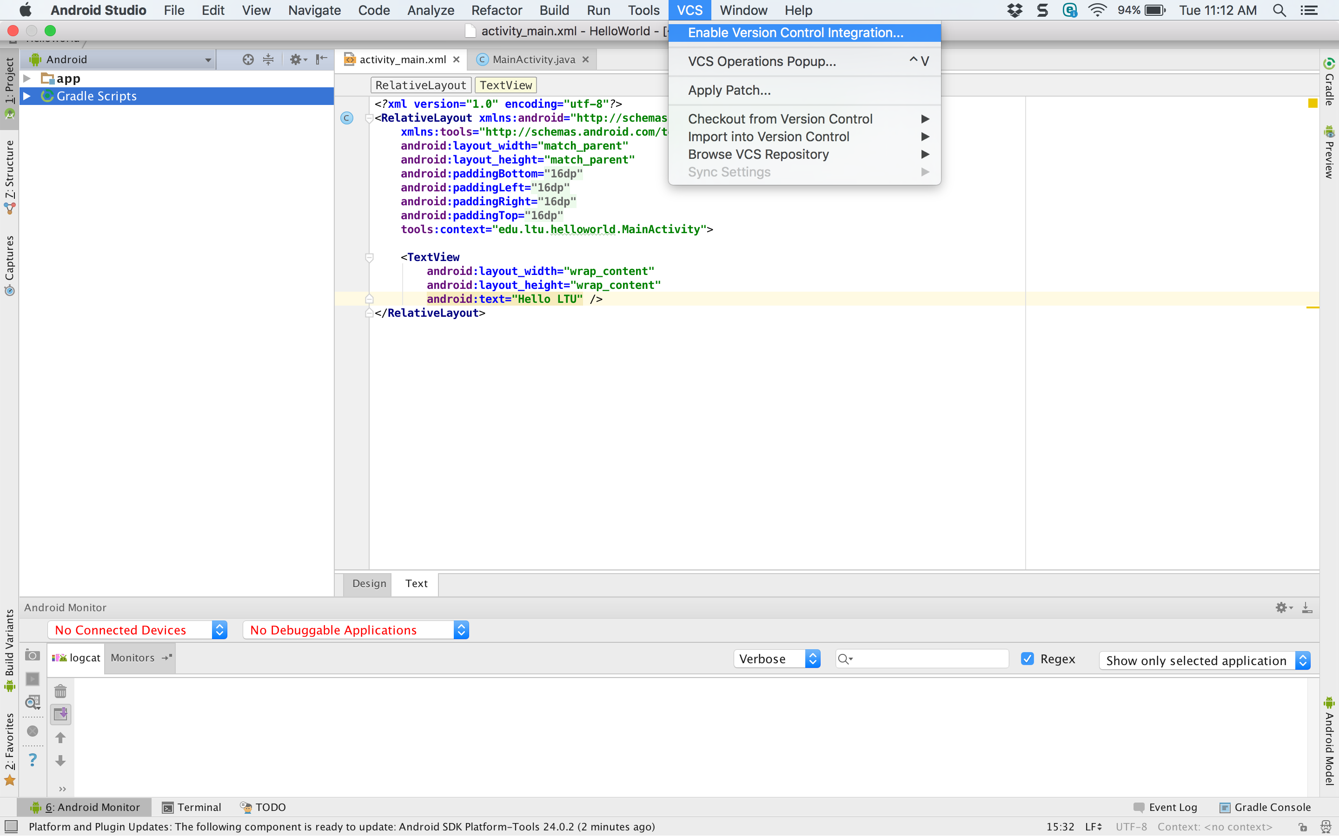
Github
Notes:
Enable Version Control Integration in Android Studio

Slide 5
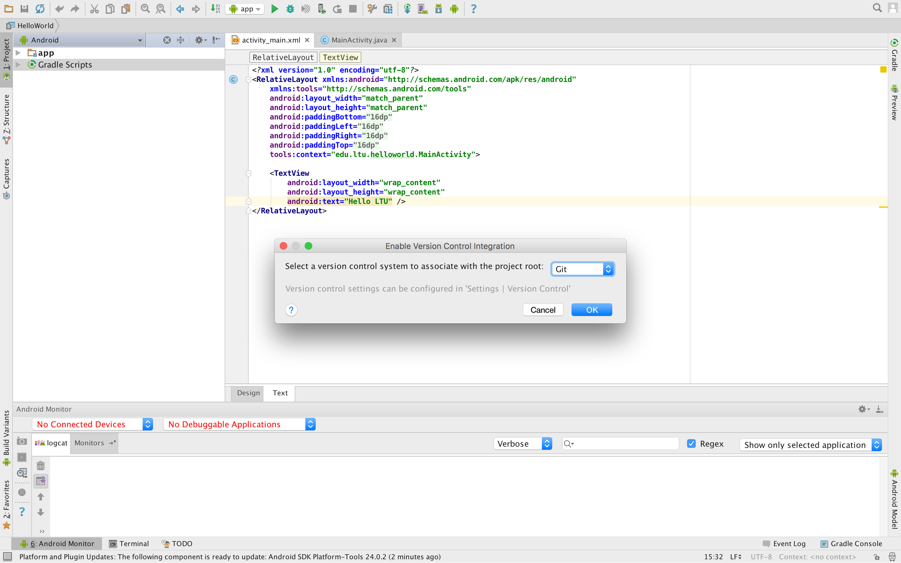
Github
Notes:
Choose Git as your Version Control Integration

Slide 6
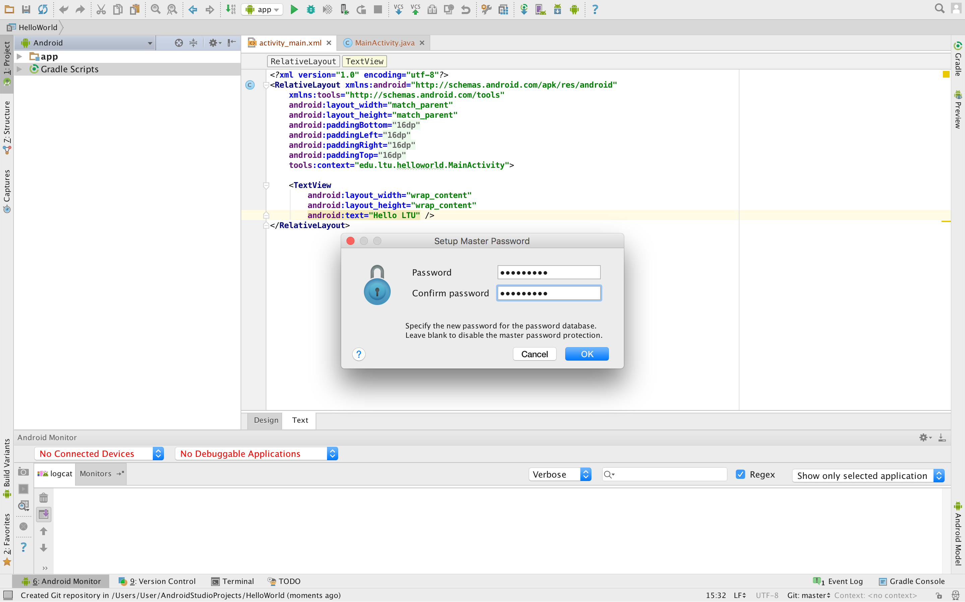
Github
Notes:
If you haven’t set up git in Android Studio before it’s going to ask you for a Master Password for the local database, you can enter something or leave it blank.

Slide 7
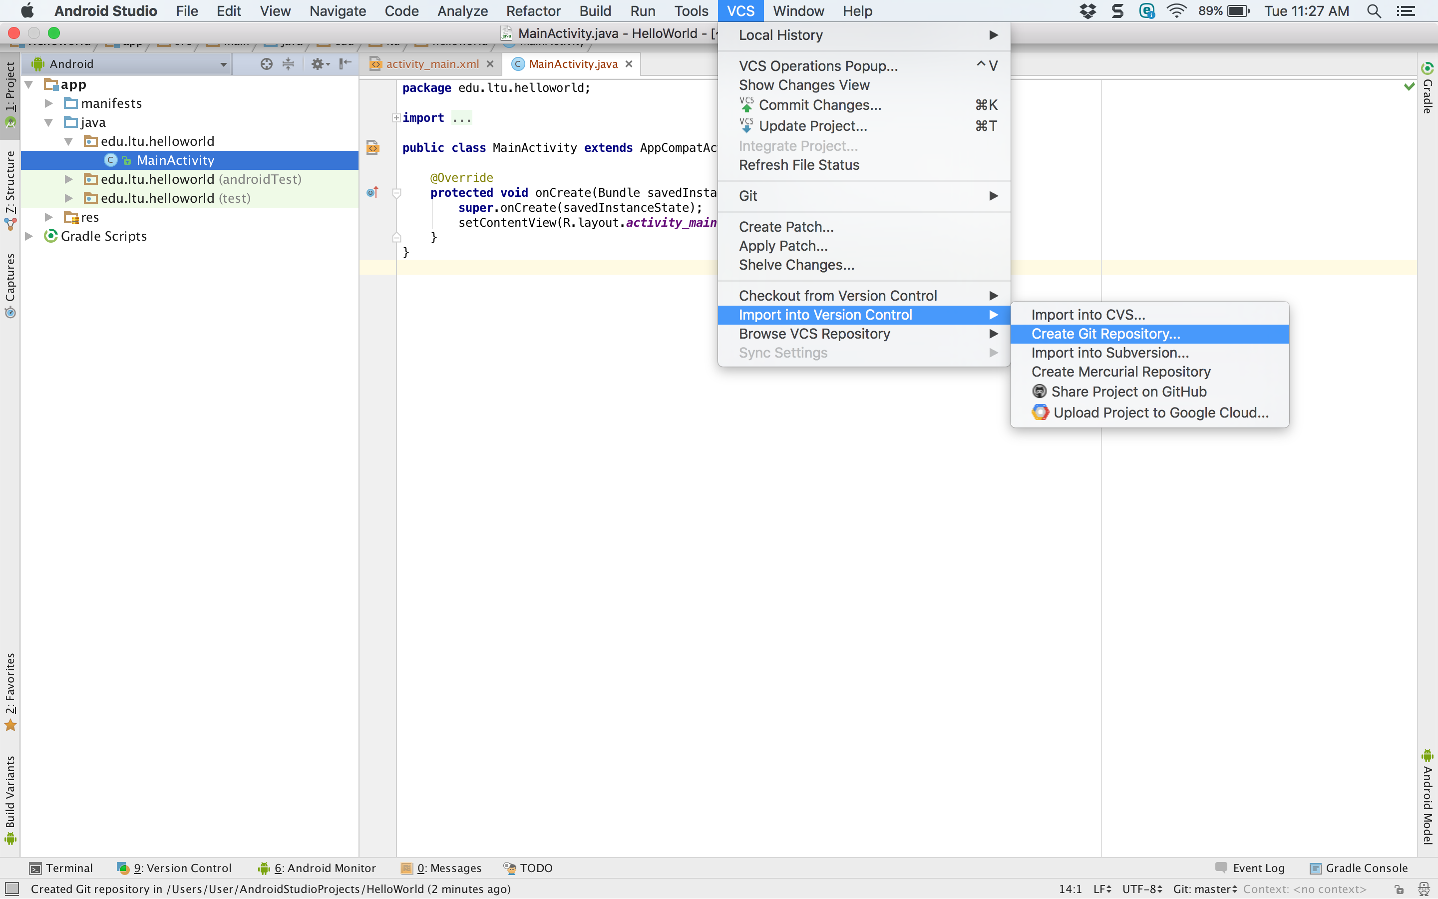
Github
Notes:
Choose Import Into Version Control -> Create Git Repository
And accept the default answers

Slide 8
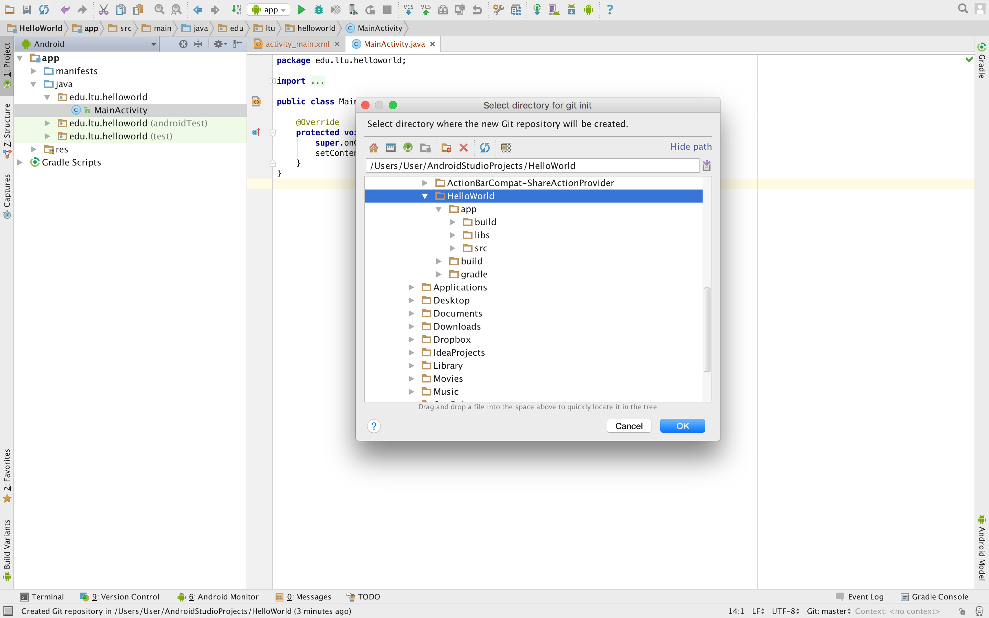
Github
Notes:
Select the root of your project when you’re asked to ‘Select directory for git init’

Slide 9
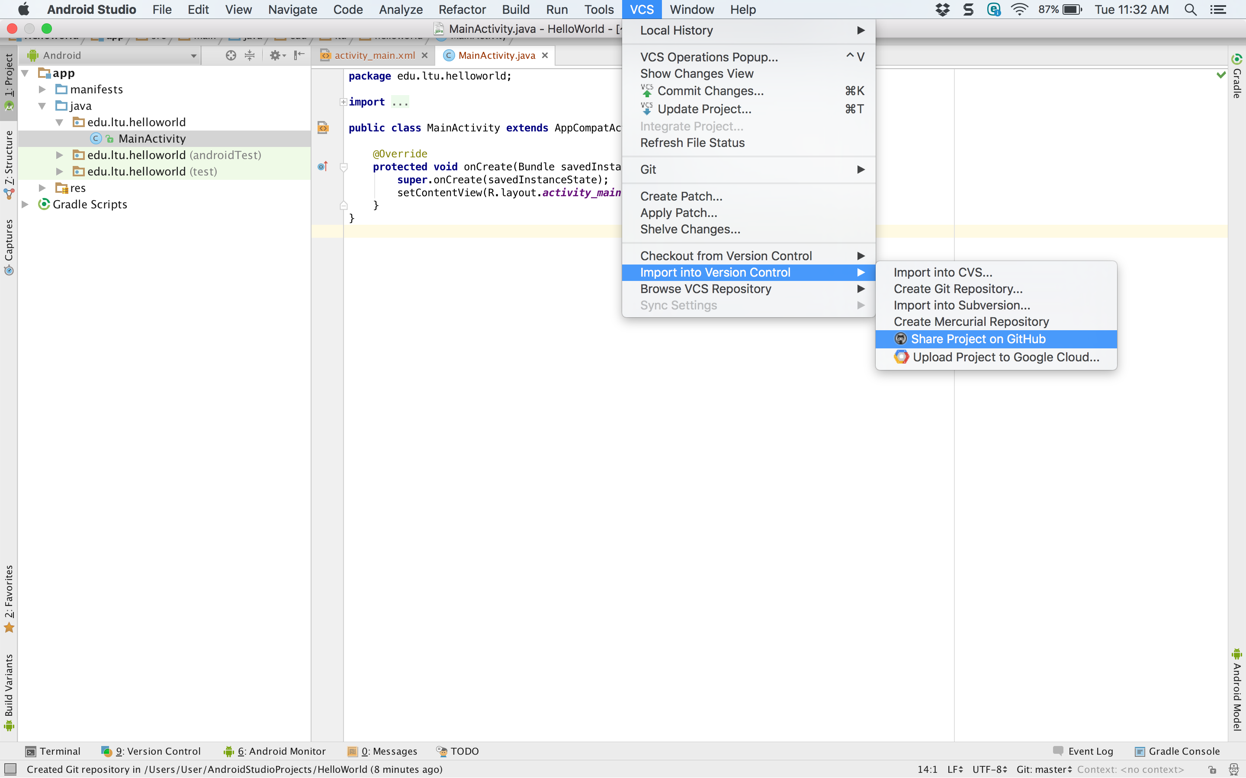
Github
Notes:
Now you want to share it on Github so the world can see it or probably just me.

Slide 10
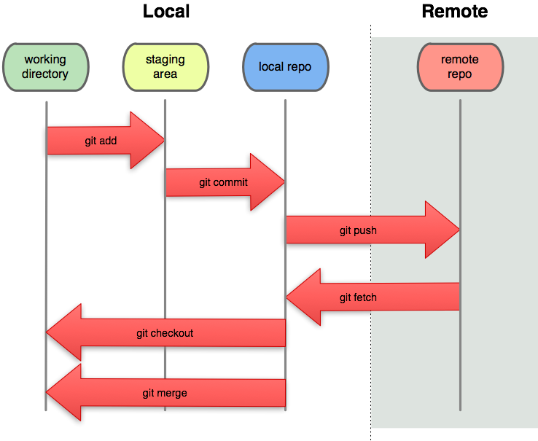
Github
Notes:
Git is local, github is remote. Android Studio will hide this all from you but you may be wondering why you need an extra push step.

Slide 11
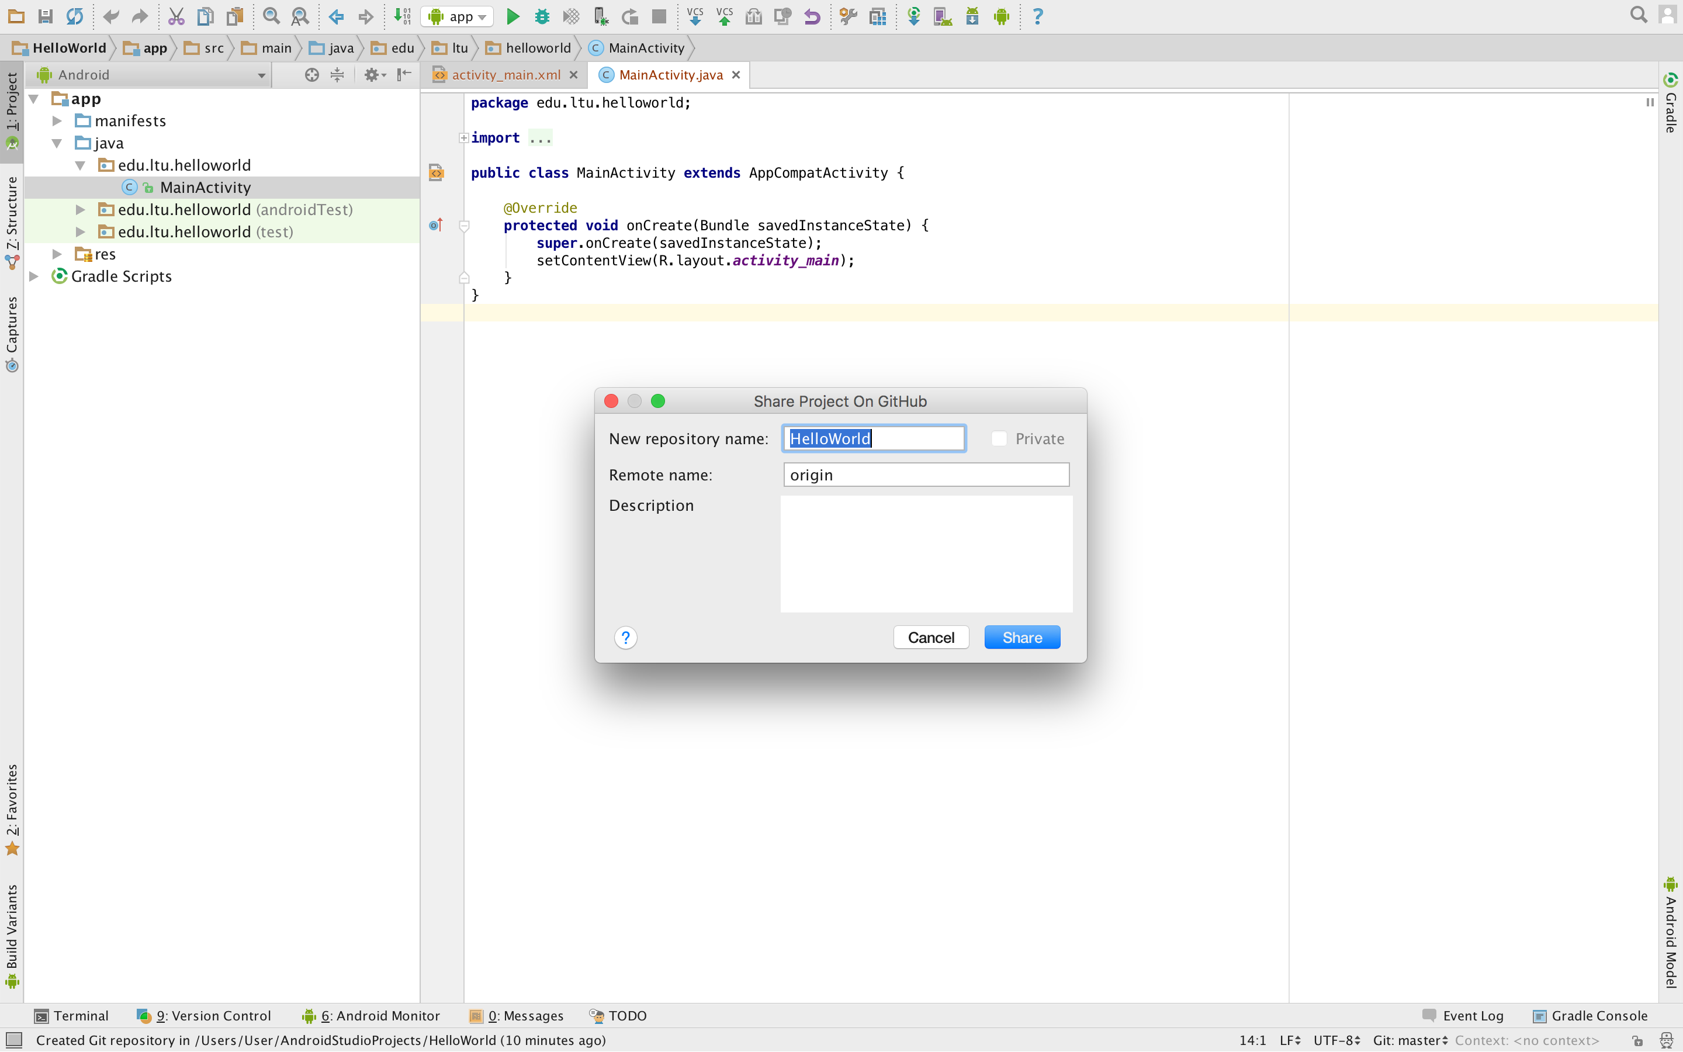
Github
Notes:
Create the HelloWorld repository

Slide 12
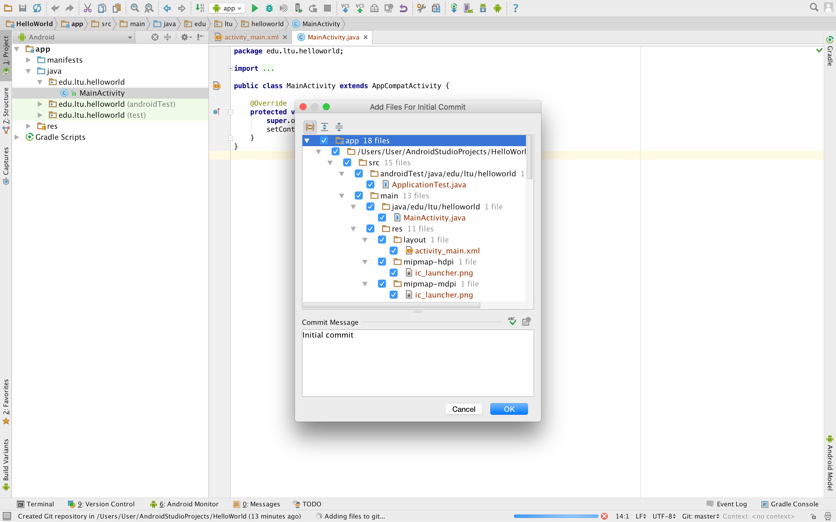
Github
Notes:
Upload all the files. Note the initial commit message

Slide 13
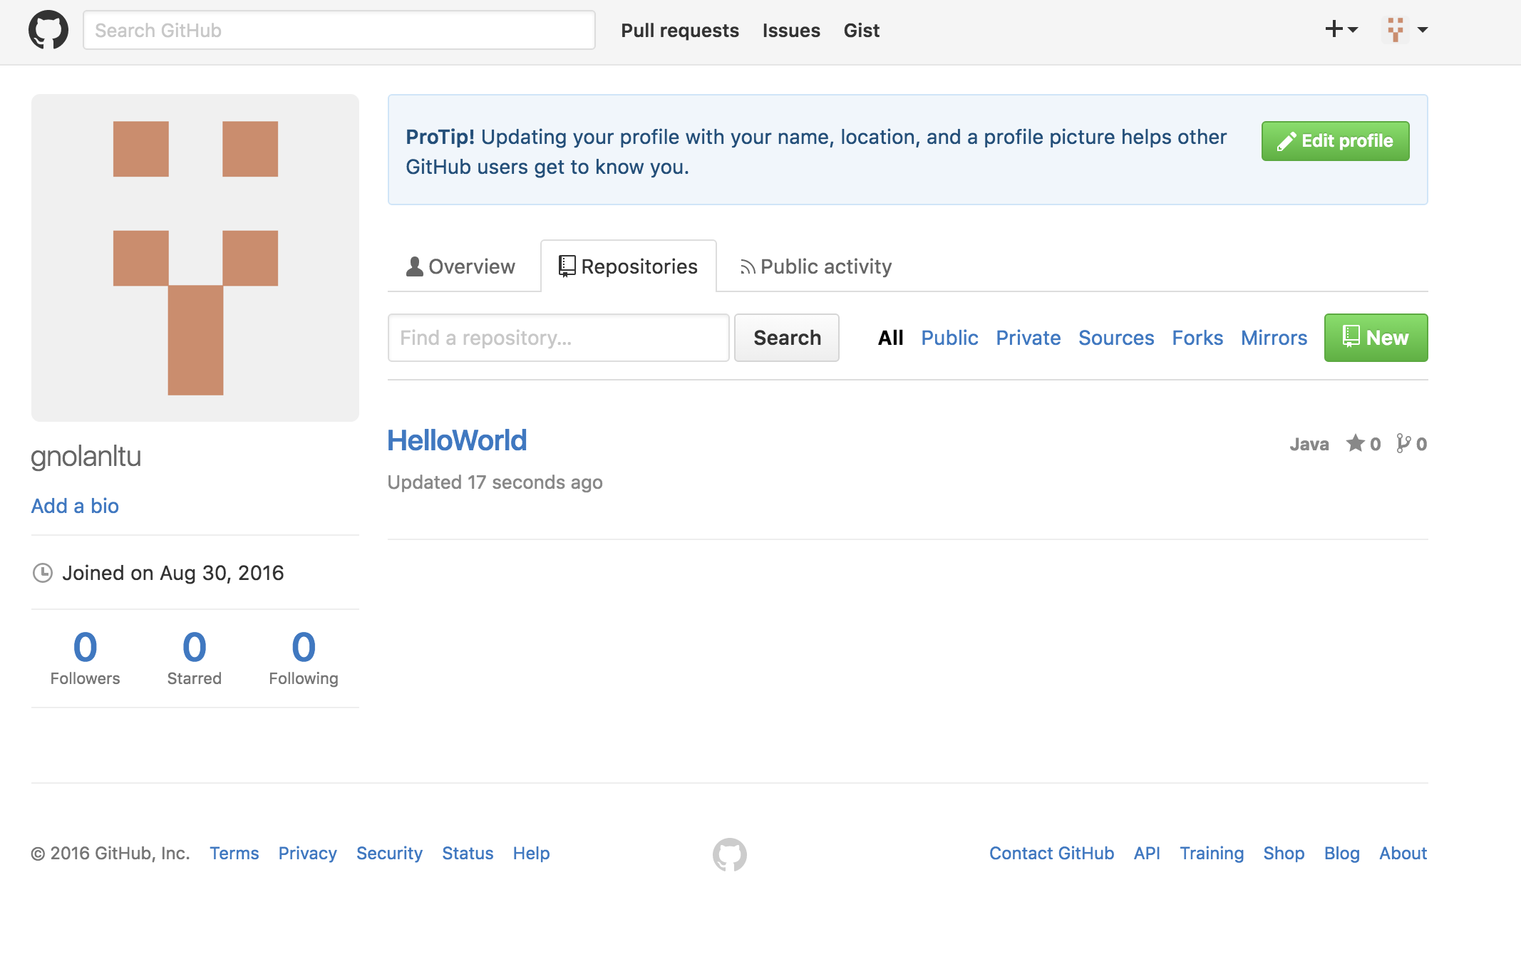
Github
Notes:
Now look at the files on Github – view the repo

Slide 14
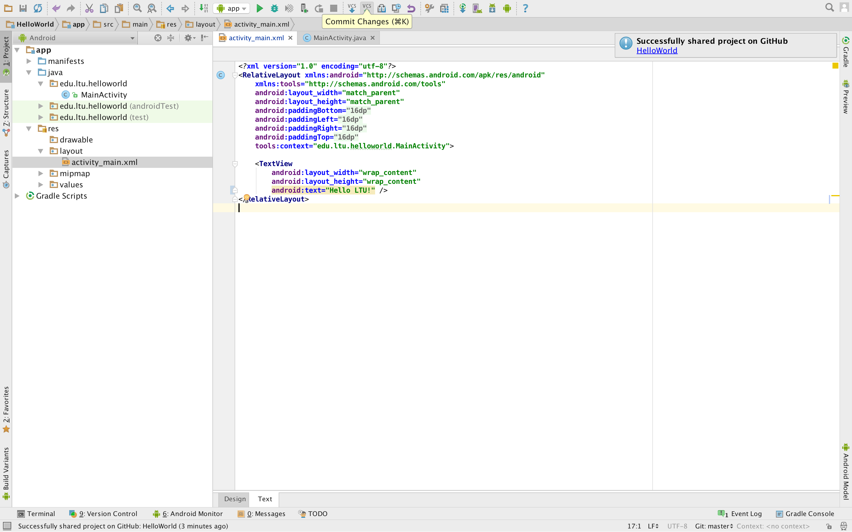
Github
Notes:
Change the file – show what it looks like in Github

Slide 15
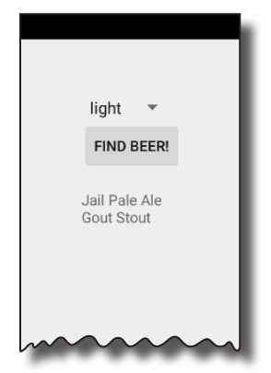
Chap 2 – Building Interactive apps
Button & Spinner elements
Array of string values
String references
onClick and clickMethod
R.java
findViewById()
setText()
getSelectedItem()
Adding new Java Class

Slide 16
Chap 2 – Building Interactive apps
Create Project
Update layout
Connect activity
Write Application Logic
Notes:
You’re creating a brand-new app, so you’ll need to create a new project. Just like before, you’ll need to create a basic layout and activity.
Once you have a basic app set up, you need to amend the layout so that it includes all the GUI components your app needs.
The layout only creates the visuals. To add smarts to your app, you need to wire the layout to the Java code in your activity.
You’ll add a Java custom class to the app, and use it to make sure users get the right beer based on their selection.

Slide 17
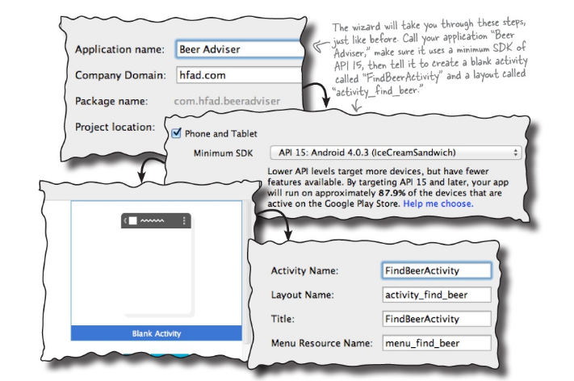
Chap 2 – Create Project

Slide 18
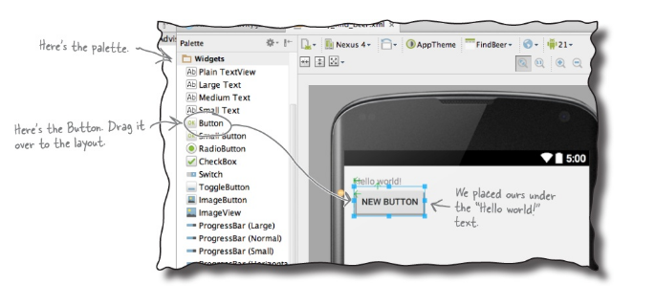
Chap 2 – Update Layout
Notes:
The editor added a new <Button> element to activity_find_beer.xml:

Slide 19
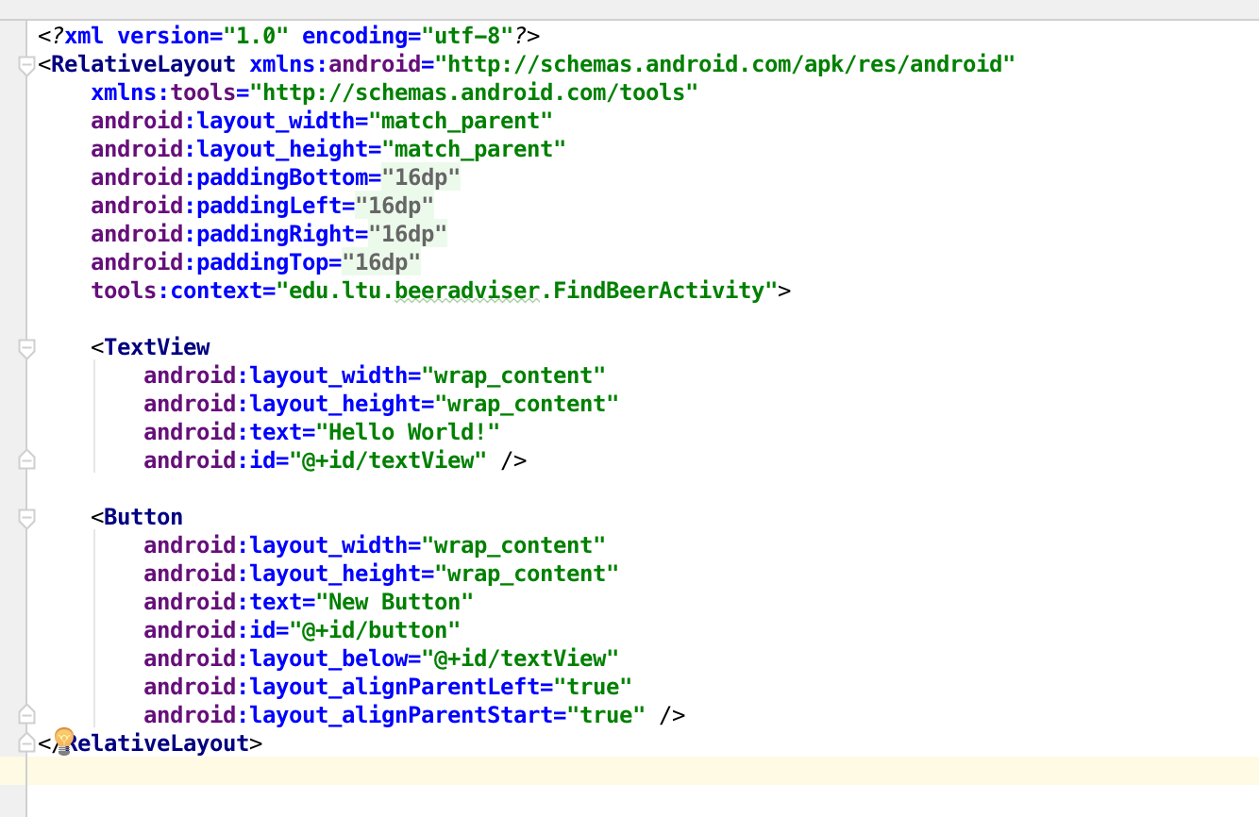
Chap 2 – Update Layout
Notes:
android:id="@+id/button”
android:text="New Button”
android:layout_width="wrap_content"
android:layout_height="wrap_content”
Relative Layout

Slide 20
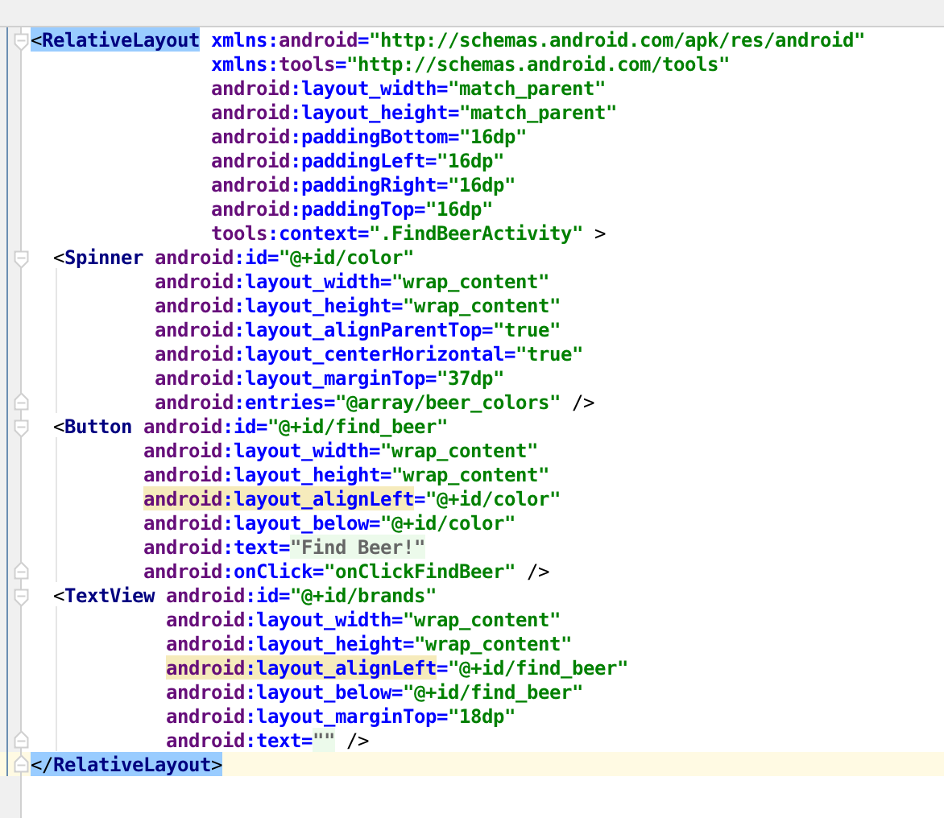
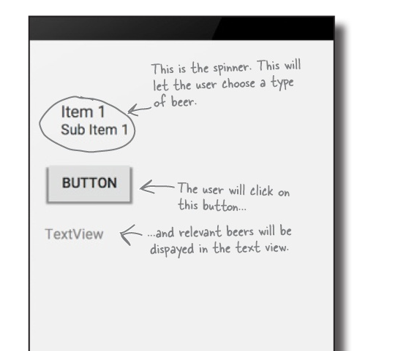
Notes:
Replace your activity_find_beer.xml code with the following, add a spinner and a textview

Slide 21
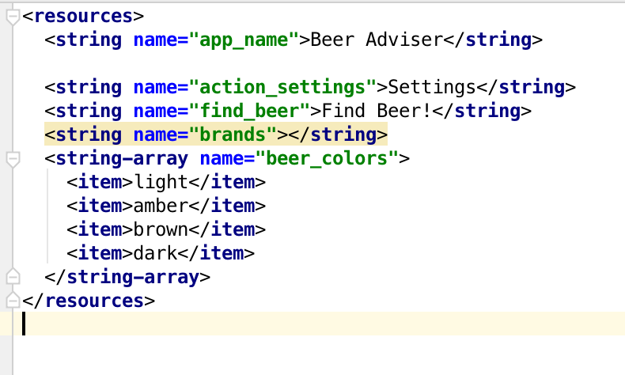
Notes:
Add the array for the spinner text

Slide 22
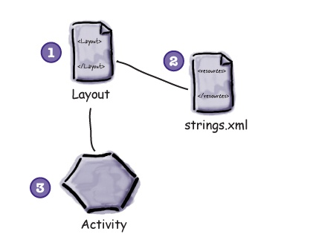
Notes:
We’ve created a layout that specifies what the app will look like.
It includes a spinner, a button, and a text view.
The file strings.xml includes the string resources we need.
We’ve added a label for the button, and an empty string for the brands.
The activity specifies how the app should interact with the user.
Android Studio has created a basic activity for us, but we haven’t done anything with it yet.

Slide 23
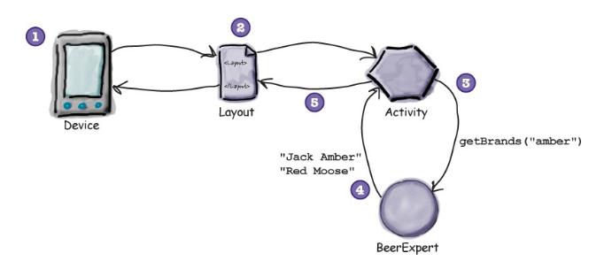
Chap 2 – Connect Activity
Notes:
The user chooses a type of beer from the spinner.
The user clicks on the button to find matching beers.
The layout specifies which method to call in the activity when the button is clicked.
The method in the activity retrieves the value of the selected beer in the spinner and passes it to the getBrands() method in a Java custom class called BeerExpert.
BeerExpert’s getBrands() method finds matching brands for the type of beer and returns them to the activity as an ArrayList of Strings.
The activity gets a reference to the layout text view and sets its text value to the list of matching beers.
This is displayed on the device.

Slide 24
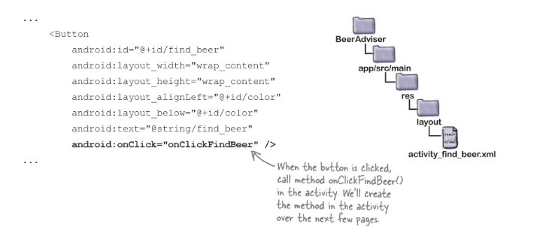
Chap 2 – Connect Activity
Notes:
We need to change the layout file activity_find_beer.xml.
We’ll specify which method in the activity will get called when the button is clicked.
USE ONCLICK TO SAY WHICH METHOD THE BUTTON CALLS
add an android:onClick attribute to the <button> element, and give it the name of the method you want to call:

Slide 25
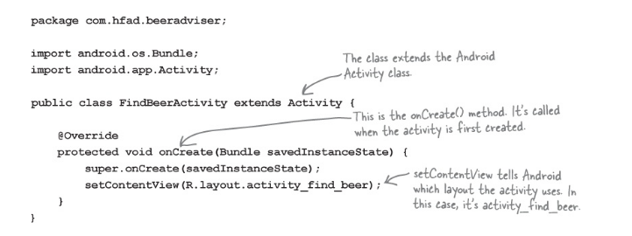
Chap 2 – Connect Activity
Notes:
We need to change the activity file FindBeerActivity.java.
We need to write the method that gets called.
we added an onClick attribute to the button in our layout and gave it a value of onClickFindBeer.
We need to add that method

Slide 26
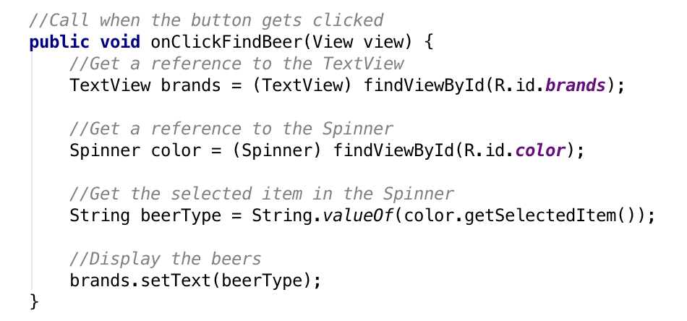
Chap 2 – Connect Activity
Notes:
This is called when the button gets clicked
R.java is a special Java file that gets generated by the Android tools whenever you create or build your app.
Android uses R to keep track of the resources used within the app, and among other things it enables you to get references to GUI components from within your activity code.
R is a special Java class that enables you to retrieve references to resources in your app.

Slide 27
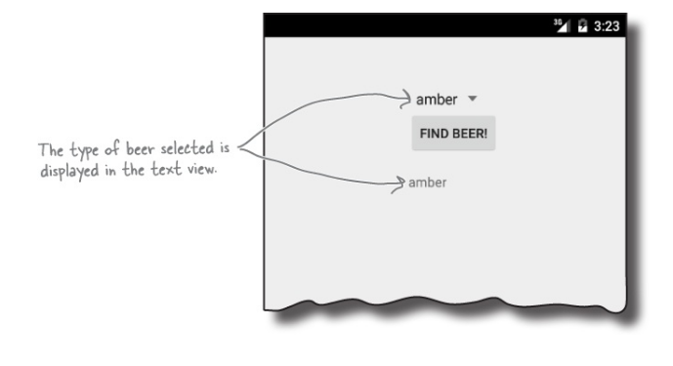
Chap 2 – Write Logic
Notes:
Need to do something so the text view is updated

Slide 28
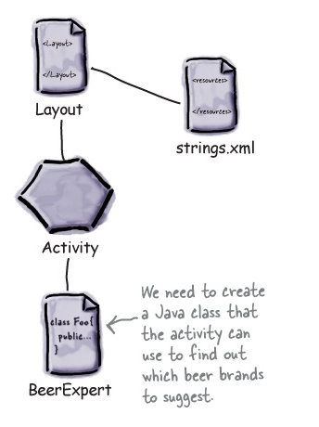
Chap 2 – Write Logic
Notes:
Need a Java class with the following requirements:
The package name should be com.hfad.beeradviser.
The class should be called BeerExpert.
It should expose one method, getBrands(), that takes a preferred beer color (as a String), and return a List<String> of recommended beers.

Slide 29
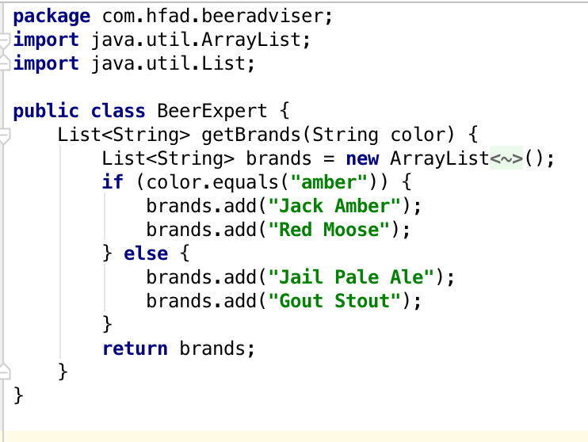
Chap 2 – Write Logic
Notes:
Simple plain old Java class that returns an array of strings based on the color
If it’s amber you get Jack Amber and Red Moose anything else gets Jail Pale Ale and Gout Stout
Now we need to go back and update our onClickFindBeer() so it can update the textview

Slide 30
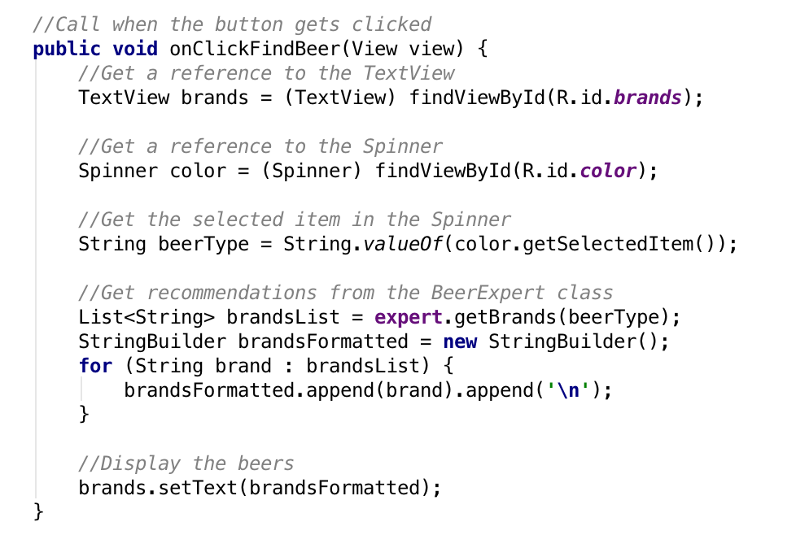
Chap 2 – Write Logic
Notes:
Uses the BeerExpert class to get a list of brands
Then build a string displaying each brand on a new line
Finally display the string in the textview

Slide 31
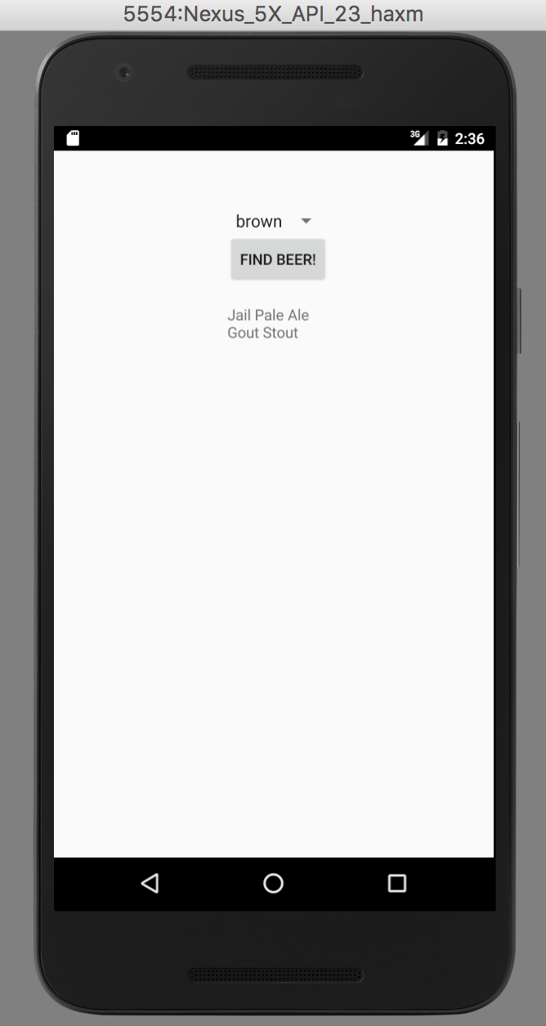
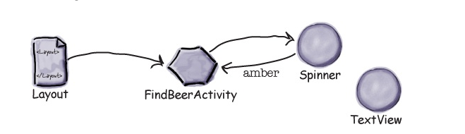
Chap 2 – Building Interactive apps
Notes:
When the user clicks on the Find Beer button, the onClickFindBeer() method in the activity gets called.
The method creates a reference to the spinner and text view, and gets the currently selected value from the spinner.

Slide 32

Chap 2 – Building Interactive apps
Notes:
The onClickFindBeer() calls the getBrands() method in the BeerExpert class, passing in the type of beer selected in the spinner. The getBrands() method returns a list of brands.

Slide 33
Chap 2 – Building Interactive apps
Notes:
The onClickFindBeer() method formats the list of brands and uses it to set the text property in the text view.

Slide 34
Chap 2 – Building Interactive apps
Button & Spinner elements
Array of string values
String references
onClick and clickMethod
R.java
findViewById()
setText()
getSelectedItem()
Adding new Java Class
Notes:
Show working app in Android Studio and emulator

Slide 35
Assignment
Push your HelloWorld project to your own github repo
Read Chapter 2

